Slide 1
The Mobile Store

Slide 2
Team
Vicky Desai : Front End (HTML/CSS)
Suraj Shah : Front End (HTML/PHOTOSHOP)
Bhavik Shah : Back End (PHP/MySQL)

Slide 3
Goal and Objective
Goal :
The main goal of this project is to develop a user friendly, responsive and dynamic website, where user can buy mobile phone from different range of mobile brands.
Objectives :
The core objective of this website is to provide an online platform from where user can choose and buy a variety of mobile phones.

Slide 4
Target Users
University students to senior citizens – age group of 18 to 60 years.
Age : 18+
Gender : All
Education : No specific education requires. Anyone who has knowledge of how to use internet is ideal user for us.

Slide 5
Features
User can buy diverse range of mobile phones which is categorized by widely known brands.
All mobile phone will be categorised with respective to their brand.
User can read the description, features as well as specification of mobile phones.
User can view different pictures of the mobile phones.
First time users can easily register themselves just by providing basic details. E.g. name, phone number, residential address and email address

Slide 6
Features
User can search mobile phones based on their interest.
User can see and manipulate products added to the cart.
Login for existing users and signup for new users.
Social media account links.

Slide 7
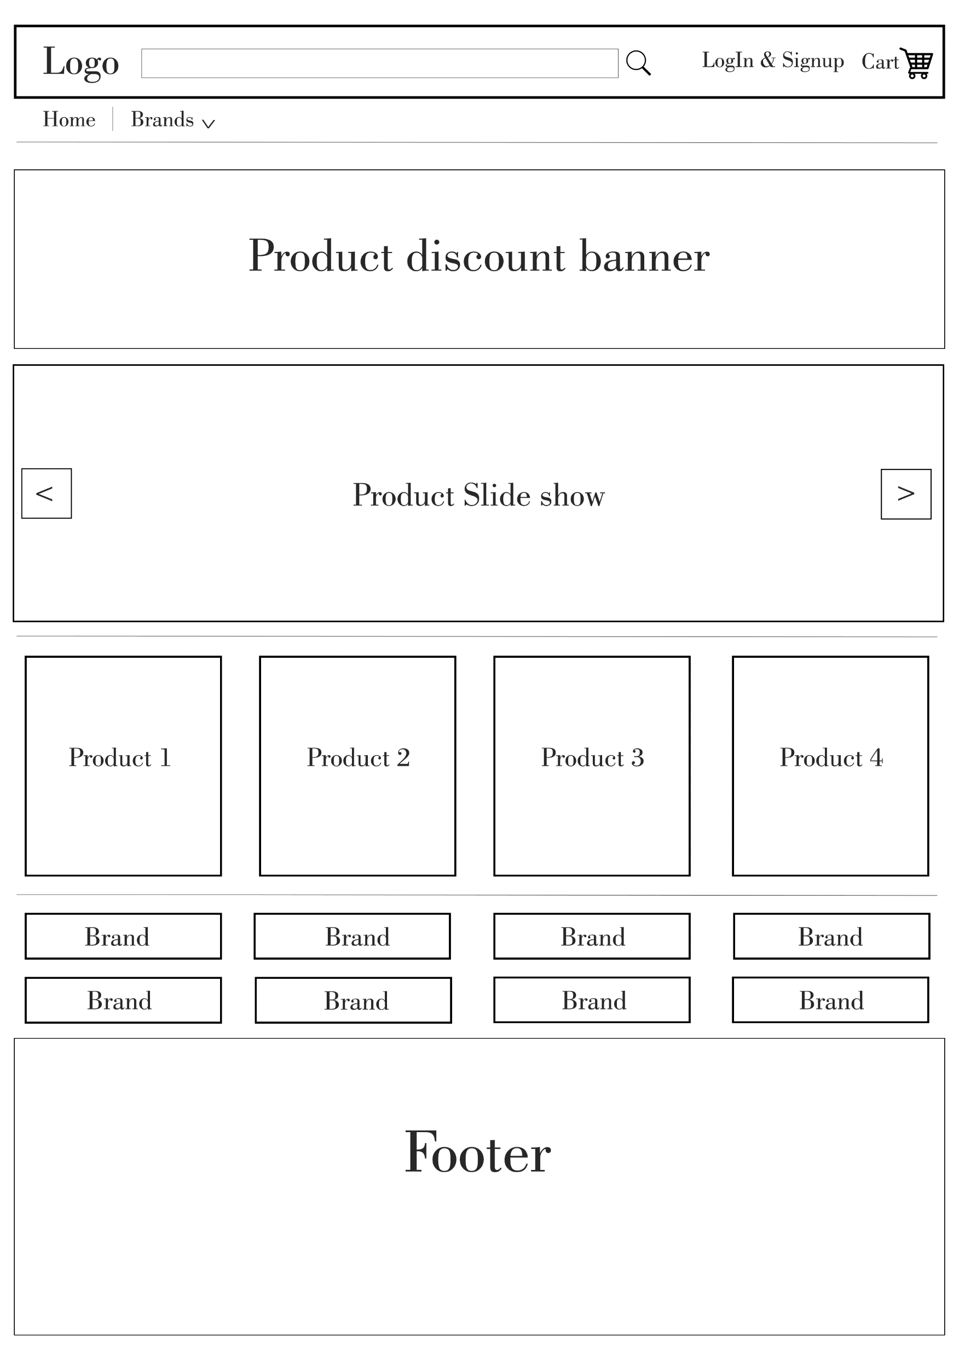
Home page Visual representation

Slide 8
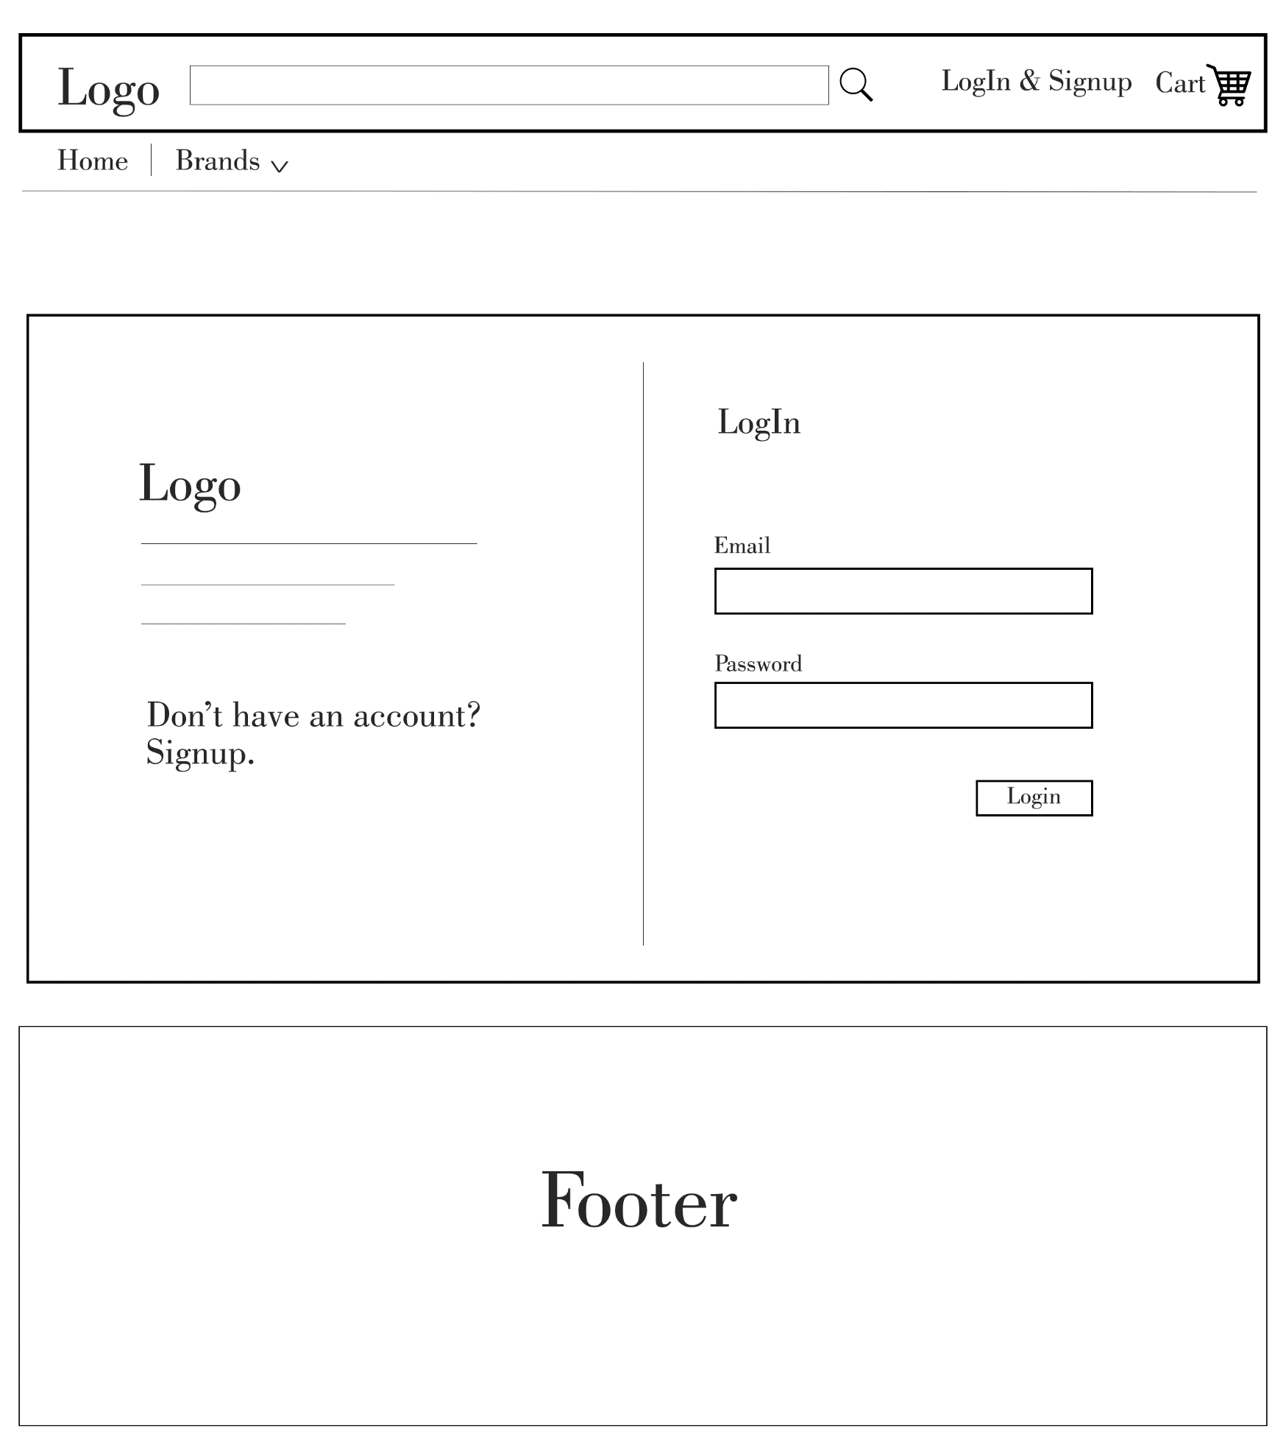
LogIn page Visual representation

Slide 9
Technologies
Front End : HTML, CSS, JavaScript, Jquery, Bootstrap
Back End – PHP, MySQL, JSON/XML
Tool :Dreamweaver, sublime (Front End), XAMPP (Back End)

Slide 10
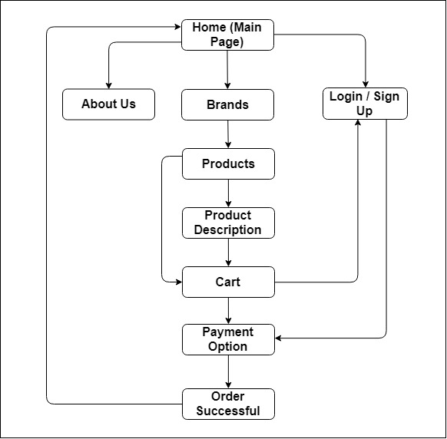
Site Blueprint

Slide 11
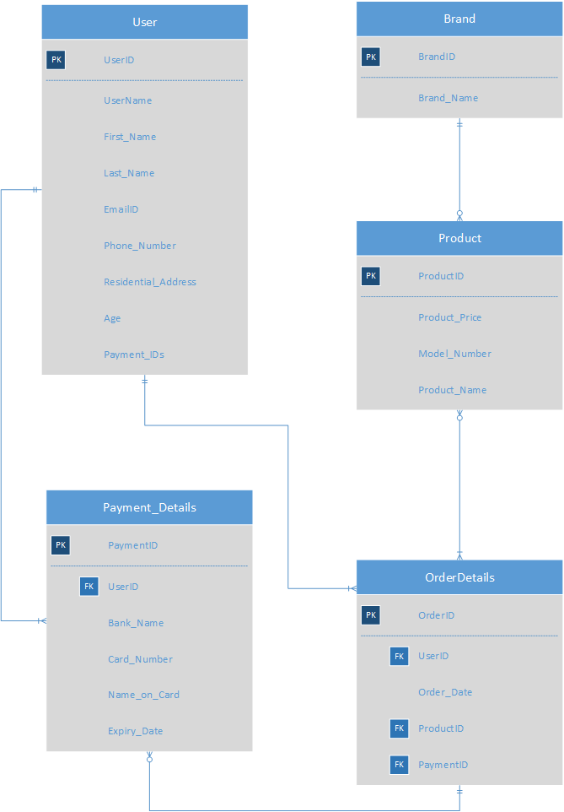
E-R Diagram

Slide 12
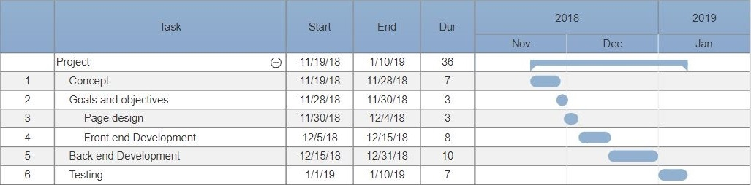
Gantt Chart

Slide 13
Thank you

